Slide 1
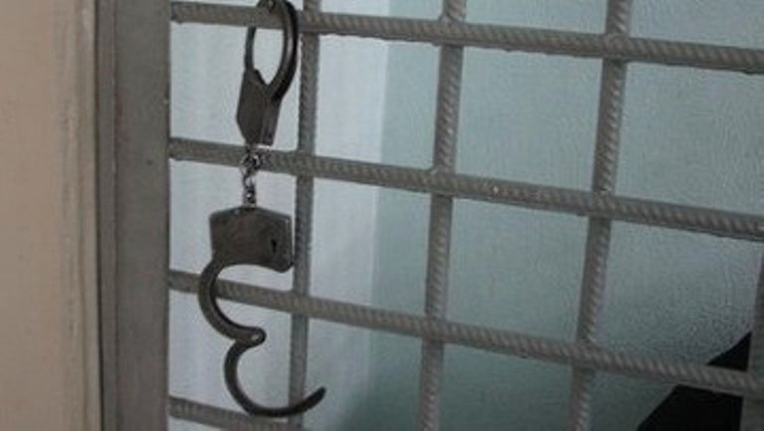
English for lawyers
What is crime

Slide 2
What is crime?
Crime is activity which is against the law: for example, if you steal someone's property, you are committing a crime and breaking the law. Some offences are only minor, e.g. illegal parking; but for more serious and especially violent crimes, e.g. killing or attacking someone, a person could go to prison for a long time.

Slide 3
Glossary
against the law against the rules of a country, syn illegal.
steal sth take sth belonging to sb else without permission.
property sth that belongs to you (e.g. a computer, jewellery).
commit a crime do sth illegal.
break the law do sth illegal/against the law. opp obey the law
offence an illegal activity, syn crime.
minor not important, opp serious
violent using force to hurt sb physically, violence N-.
kill sb make sb die.
attack sb start fighting or hurting sb.
go to prison go to a place where criminals have to stay after committing a crime, syn go to jail.

Slide 4
Complete the sentences using a word from the box. Put the verbs in the correct form. violent serious against break property steal jail minor violence go attack
She did something terrible; and I heard that she ……… to prison.
There is a lot of……….in the centre of town at night.
A group of boys……….the man, but fortunately he wasn't badly hurt.
The young man………. my bike and sold it in the market.
………..was stolen from several houses in the street last night.
It was a very…………… crime; several people had to go to hospital.
He committed a……… crime, and he'll probably go to…………….. for a long time.
I've never………….the law.
He parked in the wrong place; it was only a………….offence, but it's still……………..the law.
Test yourself. Look at the glossary words and cover the meanings. Can you remember the meanings?

Slide 5
Types of crime
Crime | The crime of … | Verb | Criminal
theft | taking something which belongs to someone else without permission | He steals cars and sells them. | thief
robbery | stealing from a person or place, often using violence. | They were planning to rob the bank. | robber
burglary | entering a building illegally and stealing things from it. | They broke into the house and stole some jewellery. | burglar
shopliftig | stealing things from a shop. | She stole a skirt from the supermarket | shoplifter
mugging | attacking someone in a public place in order to steal from them. | He mugged people for their money late at night. | mugger
murder | killing someone deliberately | He murdered his neighbor Why did he shoot² | murderer

Slide 6
Complete the sentences.
The thief ……….. $1000.
Two robbers……..into the museum and……… three paintings. A guard tried to stop them, but one robber had a knife and……….him in the chest.
The driver killed a man, but it wasn't murder, because he didn't do it……..
Someone……..me on the way home last night. He had a gun and said he would……………….me if I didn't give him money and my mobile phone. It was horrible.
He will be in prison for the rest of his life for……….his wife. He bought a gun and……………..her while she was asleep.
A…………broke into our house and took our jewellery and cameras.
The three men……….that bank because it was in a very quiet area.

Slide 7
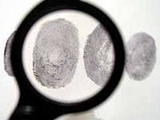
A police investigation
A crime is reported to the police, usually by the victim. The police investigate it. The victim and witnesses tell the police what they know. The police may take fingerprints, or take photos where the crime took place. If possible, they catch the suspect and arrest him. If there is enough evidence, they will charge the suspect and he will go to court.

Slide 8
Glossary
report sth | give information that sth has happened.
victim | a person who has been robbed, injured, etc.
investigate | try to find out about sth
witness | a person who sees sth happen (e.g. a crime or an accident).
Take place | happen
Catch sb | find and hold sb
suspect | a person who the police think has committed a crime
evidence | facts, signs, or objects that make you believe sth is true
Charge | say officially that they believe sb has done sth illegal

Slide 9
Circle the correct word.
When a robbery has (1)take place \reported, someone will (2) investigate/report it to the police. (3) victims/suspects and witnesses will tell the police what they saw. After that, the police will begin to (4) investigate/charge the crime. They may take photos and take (5) fingerprints/suspects where the robbery (6) took place/caught. They (7) will/may catch the (8) suspect/victim; if they do, they will (9) report/arrest him. If they have enough (10) evidence/victims, they will (11) catch/charge the suspect, and he will have to go to (12) court/the police station .

Slide 10
Answer the questions. One question has more than one answer.
Who has to find the evidence?
Who takes fingerprints?
Who is charged?
Who investigates the crime?
Who is hurt by the crime?
Who is caught?
Who usually reports the crime?
Who is arrested?
Who sees the crime take place?

Slide 11
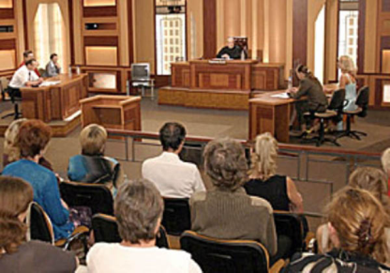
In court.
In Britain, serious crimes such as robbery and murder are tried by a judge and jury. At the trial, the prosecution aims to prove that the accused (or defendant) has committed the crime; the defence aims to prove he is innocent. At the end, the jury decides whether the defendant is guilty or not guilty. If he is guilty, he is sentenced by the judge. He may get a fine or a prison sentence.

Slide 12
Glossary
try sb | ask questions and listen to evidence in court to decide if sb has done sth illegal.
Trial | an examination of evidence in court to decide if sb has done sth illegal
prosecution | the lawyers who try to prove that the accused person has committed a crime, prosecute sb v
Prove sth | give evidence to show that sth is true, proof n.
The defense | the lawyers who try to prove hat the accused person has not committed the crime, defend sb v
Innocent | If you are innocent, you have done nothing wrong, opp guilty.
Sentence sb | tell sb who is guilty what they will have to do, e.g. go to prison. sentence
fine | a sum of money you have to pay if you break a law. fine sb v

Slide 13
True or false?
In serious crimes, the judge decides whether the accused is guilty or not. __________
The prosecution defends the accused________
The defendant is sentenced by the judge_______
If the jury decides the defendant is innocent, he may go to prison________
With serious crimes, the jury decides what the sentence will be________
The defence aims to prove that the accused did not commit the crime_______
If the accused is guilty, he may get a fine. ________
The judge has to prove whether the defendant is guilty or not_______
Trials take place in a court______

Slide 14
Complete the sentences using the words on the right in the correct form.
I may get a prison…… SENTENCE
The accused is……….by the judge and jury. TRY
The defence must……….that the accused is innocent. PROOF
The …has to show that the accused committed the crime. PROSECUTE
If the………. is guilty, he may go to prison. DEFEND
The guilty person is…………..by the judge. SENTENCE
A……..takes place in court. TRY
A person who is guilty may be…….a sum of money. FINE

